Slide 1
Back yard
Back door
Walk-in
closet
kitchen
bedroom
Back stairs
bedroom
bathroom
Living room
Driveway
Front door
porch
Front yard
Front stairs

Slide 2
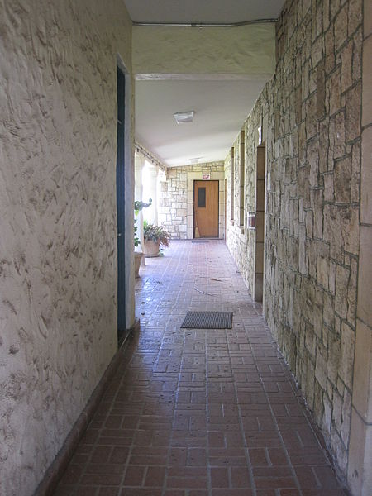
Hallway

Slide 3
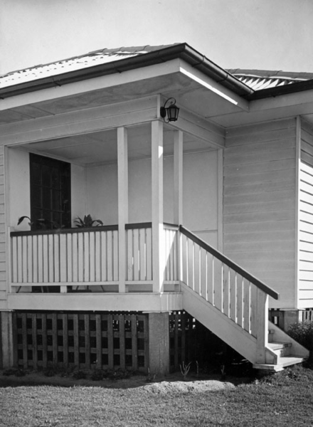
Porch

Slide 4
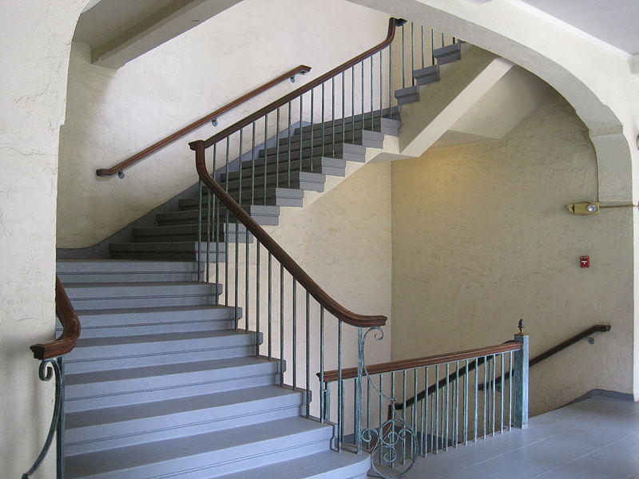
Stairwell

Slide 5
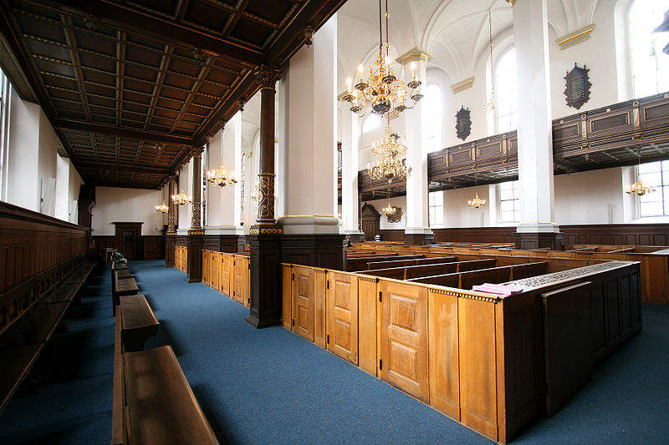
Church aisle

Slide 6
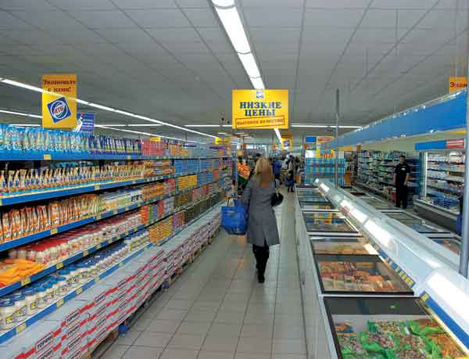
Supermarket aisle

Slide 7
Balcony

Slide 8
Patio

Slide 9
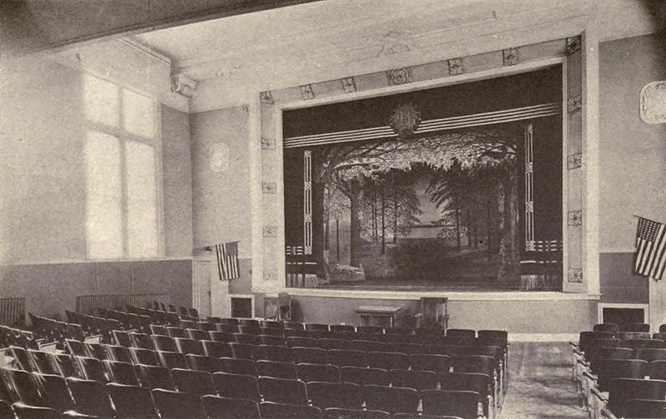
Auditorium

Slide 10
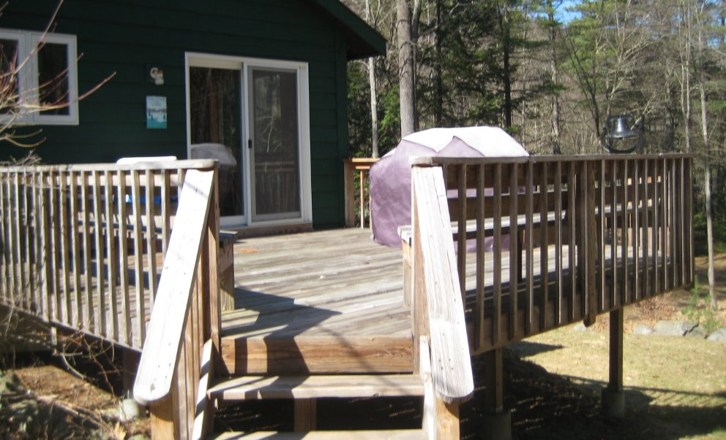
Deck

Slide 11
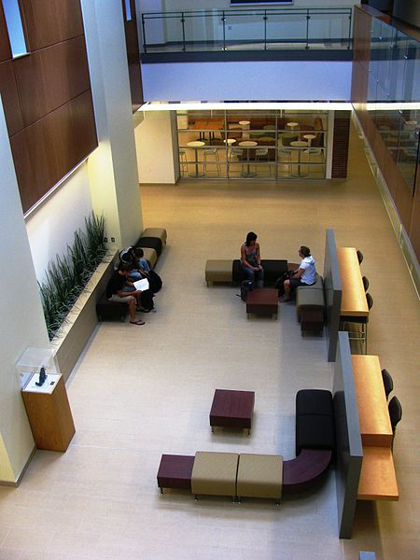
Atrium

Slide 12
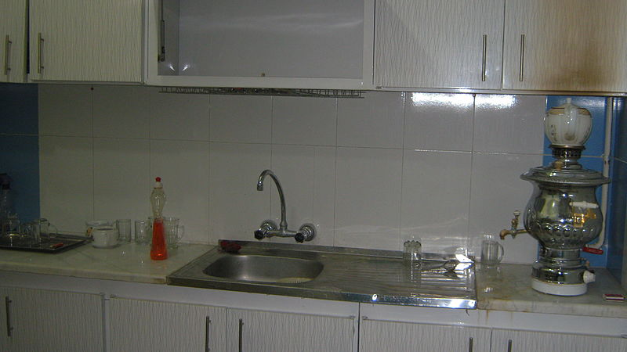
Pantry

Slide 13
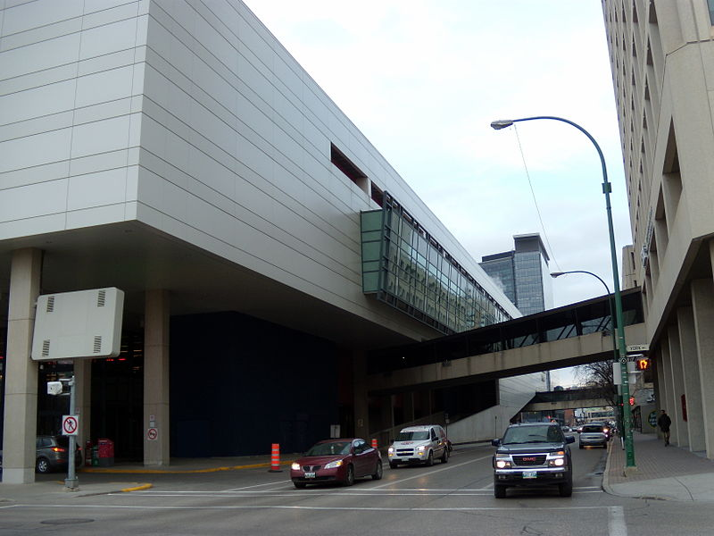
Walkway or Skywalk

Slide 14
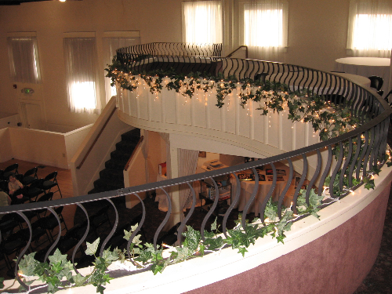
Balcony

